Slide 1
1

Slide 2


Slide 3
TCS
The Confederation of SCAC

Slide 4
Values:
We are:
Socialist Constitutional Authoritarian Convention (SCAC).
Citizens first
We believe in:
Trust, Trife and Triumph (TTT)
Notes:
Ek desh, Ek swapna
Ham hai Bharat, Ham hai Hindustan

Slide 5
Agenda:
Eradicating poverty via MMP in 2 years.
Economics:
New Taxation Policy (NTP).
Revamp of the Indian Economic Sectors. (Unemployment, Corruption, etc.…).
Eradicating poverty via MMP in 2 years. (The Liberation Army).
Political:
Qualifications for ministers.
Redrawn foreign policy (trade in ₹, Pakistan).
Indian education system revamp.
Structural developments.
Digitalisation (preventing corruption).
Legal:
Law above religion – 1 Nation 1 Policy.
Legal (faster & Efficient),
Sports:
India’s role in FIFA.
Increased funding of football.
50% decrease in unemployment.
New Taxation Policy (NTP).
Voting scheme change (2025-2026): 1 Citizen 2 Votes
Enabling Act (2024): A modern conservatism
Article 43(2025): Revised labour laws and wages.

Slide 6
Agenda:

Slide 7



Slide 9
Agenda:
Eradicating poverty via MMP in 2 years.
Economics:
New Taxation Policy (NTP).
Revamp of the Indian Economic Sectors. (Unemployment, Corruption, etc.…).
Eradicating poverty via MMP in 2 years. (The Liberation Army).
Political:
Qualifications for ministers.
Redrawn foreign policy (trade in ₹, Pakistan).
Indian education system revamp.
Structural developments.
Digitalisation (preventing corruption).
Legal:
Law above religion – 1 Nation 1 Policy.
Legal (faster & Efficient),
Sports:
India’s role in FIFA.
Increased funding of football.
50% decrease in unemployment.
New Taxation Policy (NTP).
Voting scheme change (2025-2026): 1 Citizen 2 Votes
Enabling Act (2024): A modern conservatism
Article 43(2025): Revised labour laws and wages.

Slide 10
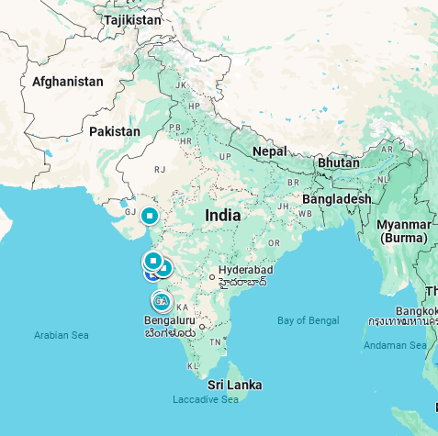







Eradicating poverty via MMP in 2 years.
50% decrease in unemployment.
New Taxation Policy (NTP).
Voting scheme change (2025-2026): 1 Citizen 2 Votes
Enabling Act (2024): A modern conservatism
Article 43(2025): Revised labour laws and wages.

Slide 11






Eradicating poverty via MMP in 2 years.
50% decrease in unemployment.
New Taxation Policy (NTP).
Voting scheme change (2025-2026): 1 Citizen 2 Votes
Enabling Act (2024): A modern conservatism
Article 43(2025): Revised labour laws and wages.

Slide 12


Slide 13

Army:
Notes:
Army flag

Slide 14

Navy & Air Force:
Notes:
Navy and air force flag

Slide 15
Agenda:
Eradicating poverty via MMP in 2 years.
Economics:
New Taxation Policy (NTP).
Revamp of the Indian Economic Sectors. (unemployment, corruption, etc.…)
Eradicating poverty via MMP in 2 years.
Political:
Voting scheme change (2025-2026).
Qualifications for ministers.
Redrawn foreign policy (trade in ₹, Pakistan)
Indian education system revamp.
Structural developments.
Digitalisation (preventing corruption).
Legal:
Law above religion – 1 Nation 1 Policy
Legal (faster & Efficient)
ACTS:
Enabling Act (2024): A modern conservatism
Article 43(2025): Revised labour laws and wages.
MMP Act (2025): Massive Militarisation Program
50% decrease in unemployment.
New Taxation Policy (NTP).
Voting scheme change (2025-2026): 1 Citizen 2 Votes
Enabling Act (2024): A modern conservatism
Article 43(2025): Revised labour laws and wages.

Slide 16
TCS
The Confederation of SCAC

